Slide 1

Regularizing your neural network
Regularization
deeplearning.ai

Slide 2
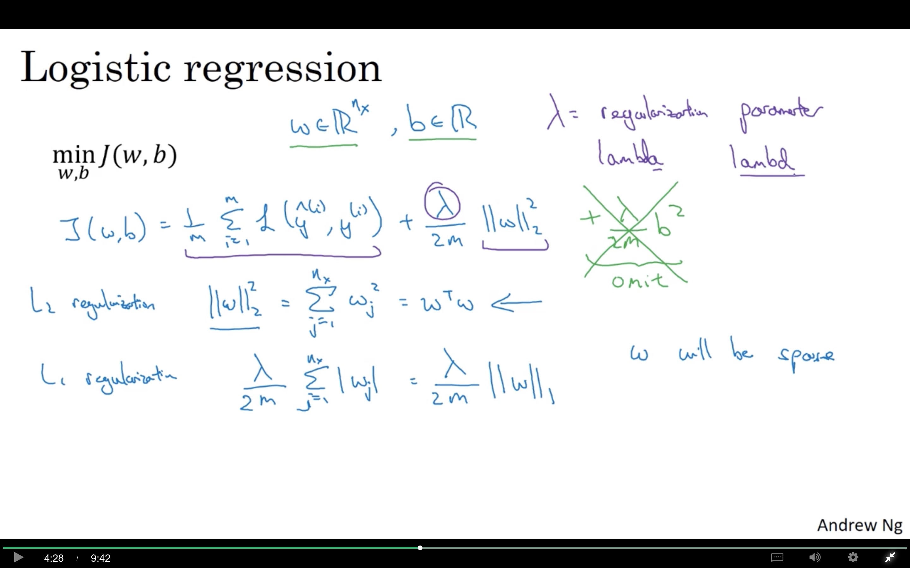

Slide 3
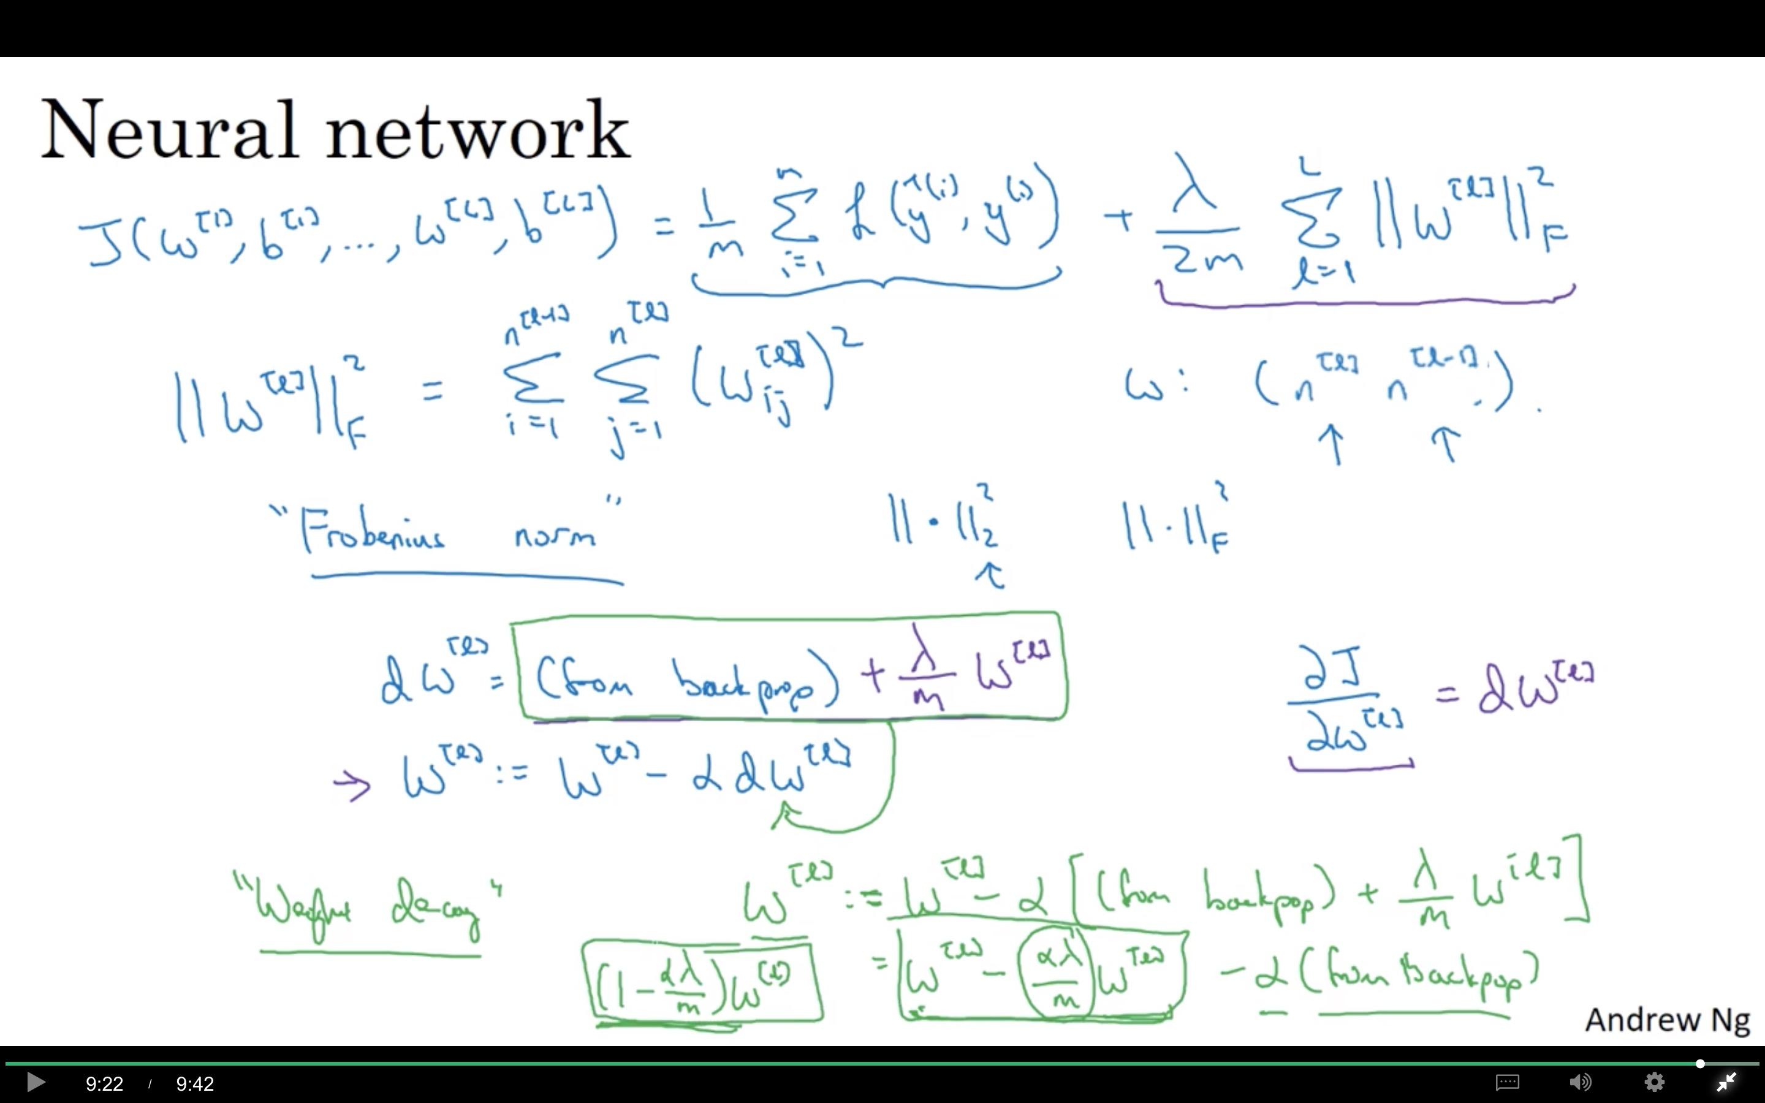

Slide 4
Regularizing your neural network
Why regularization reduces overfitting
deeplearning.ai

Slide 5
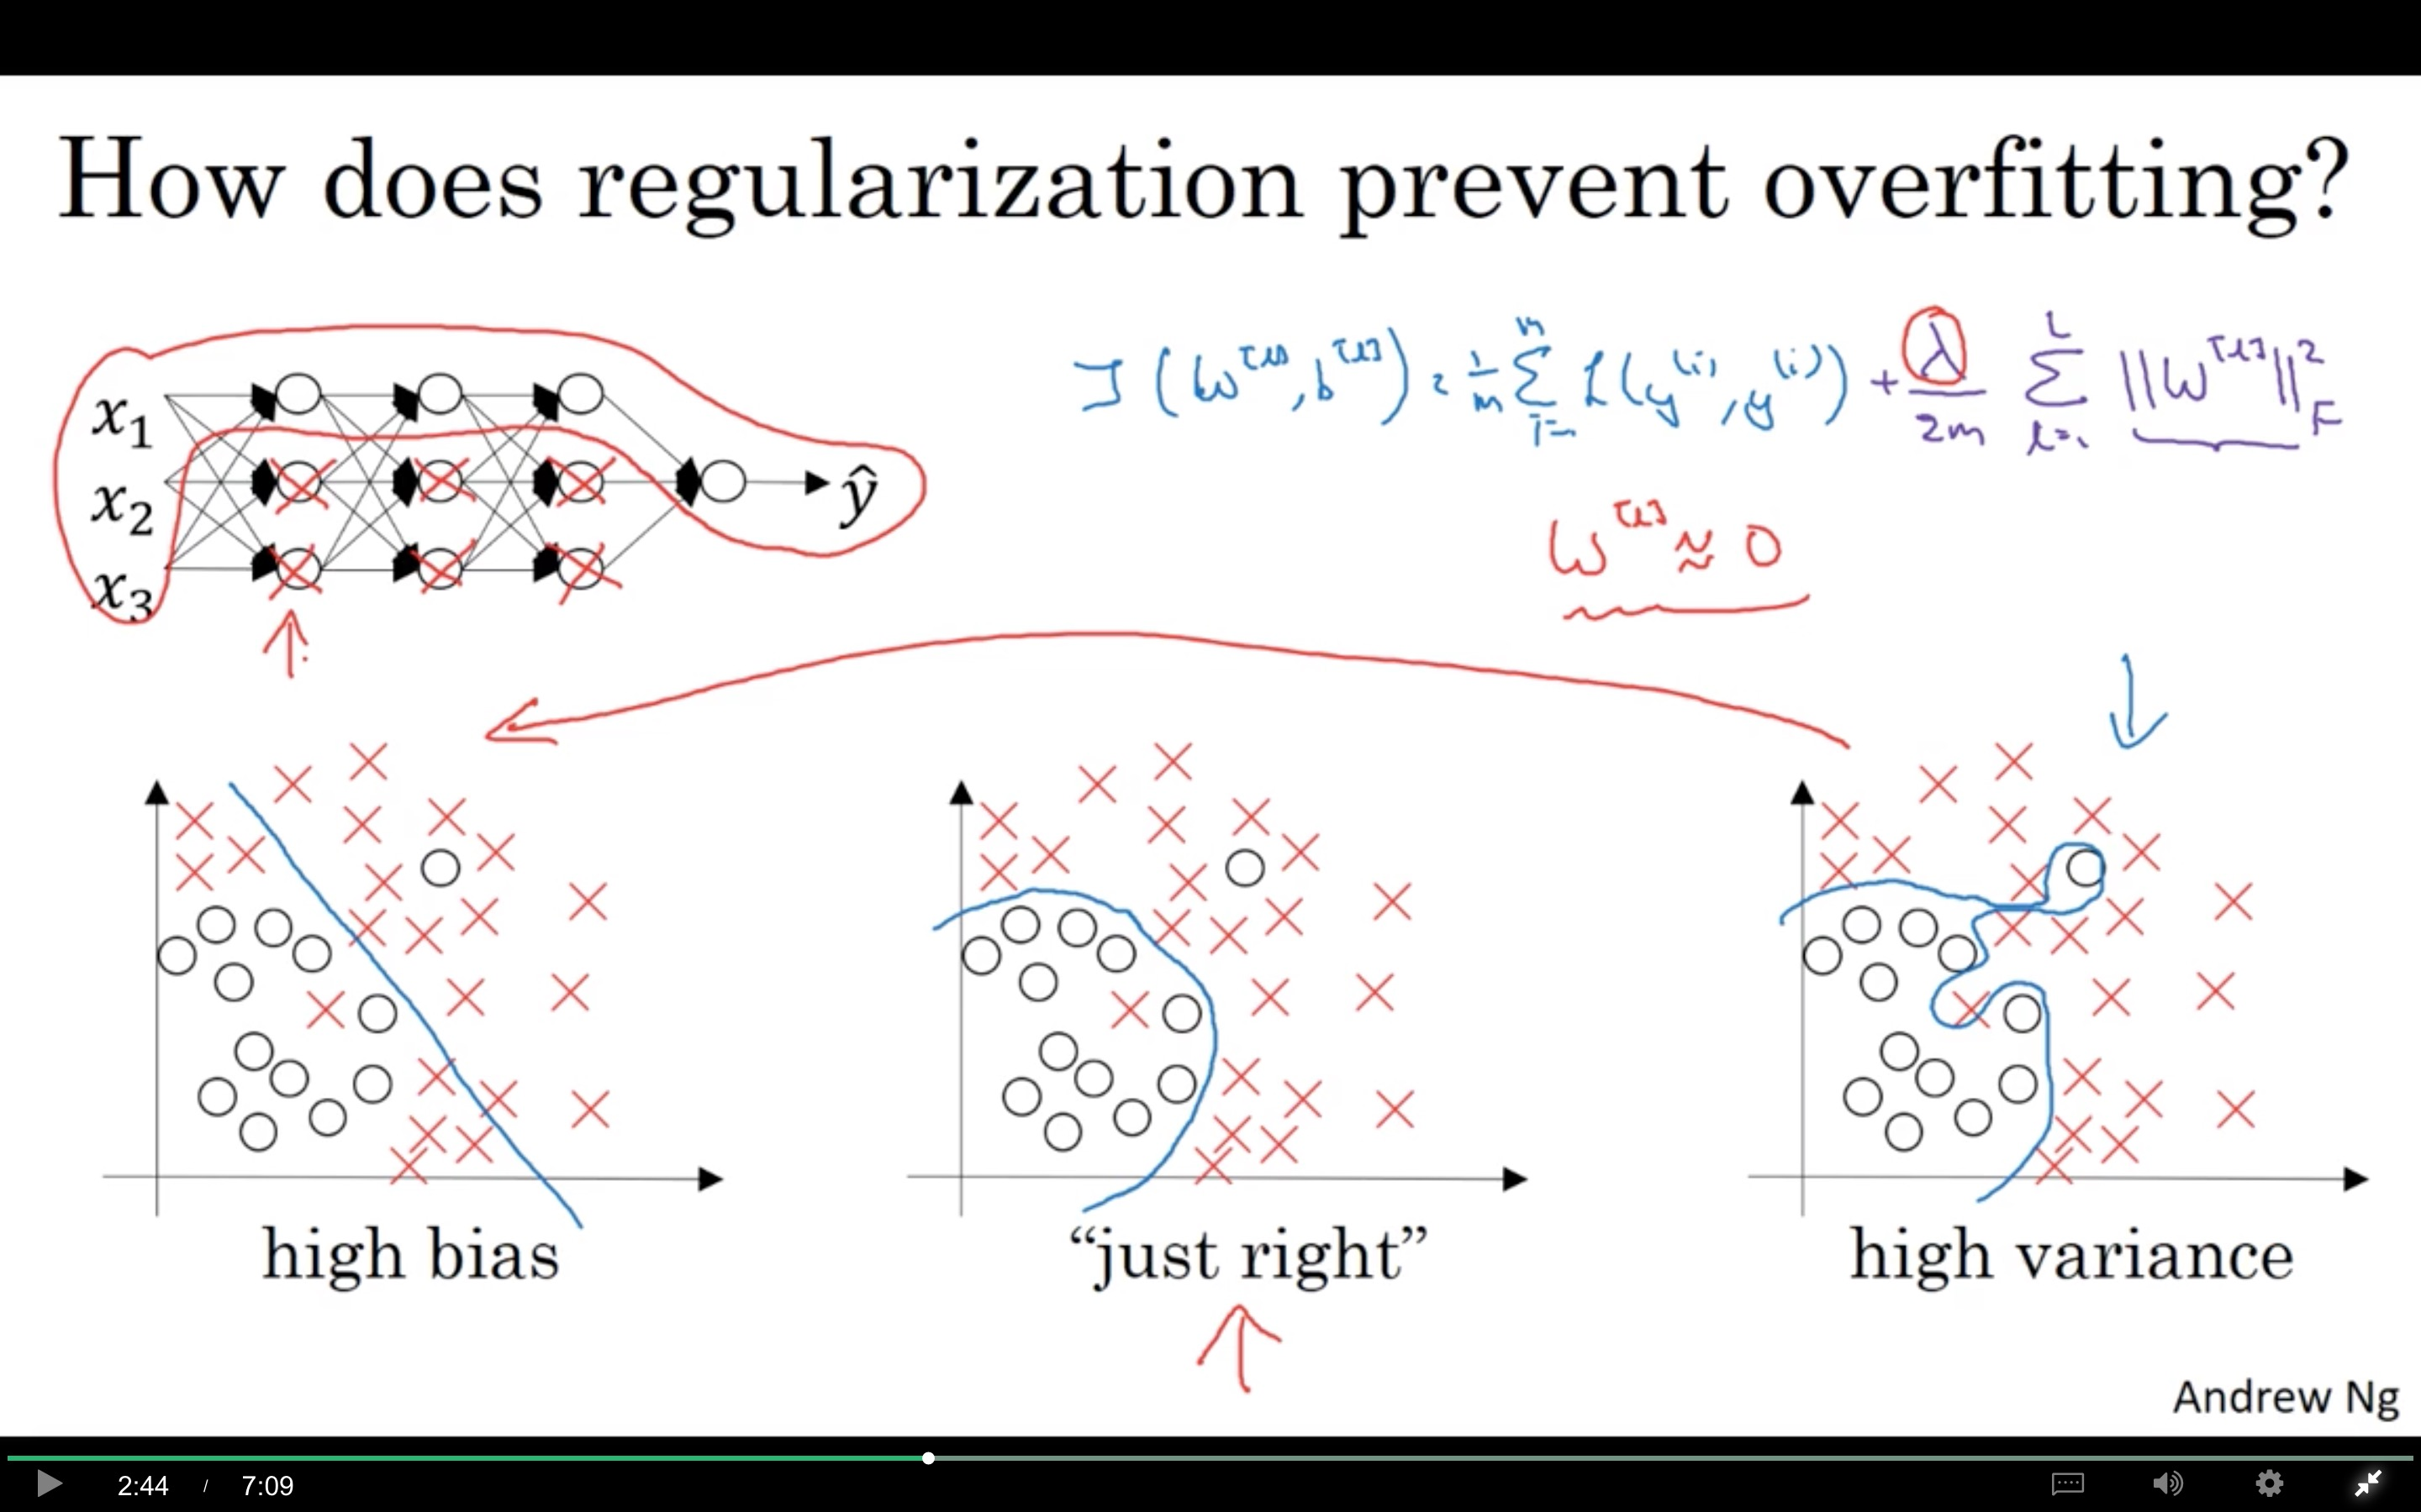

Slide 6
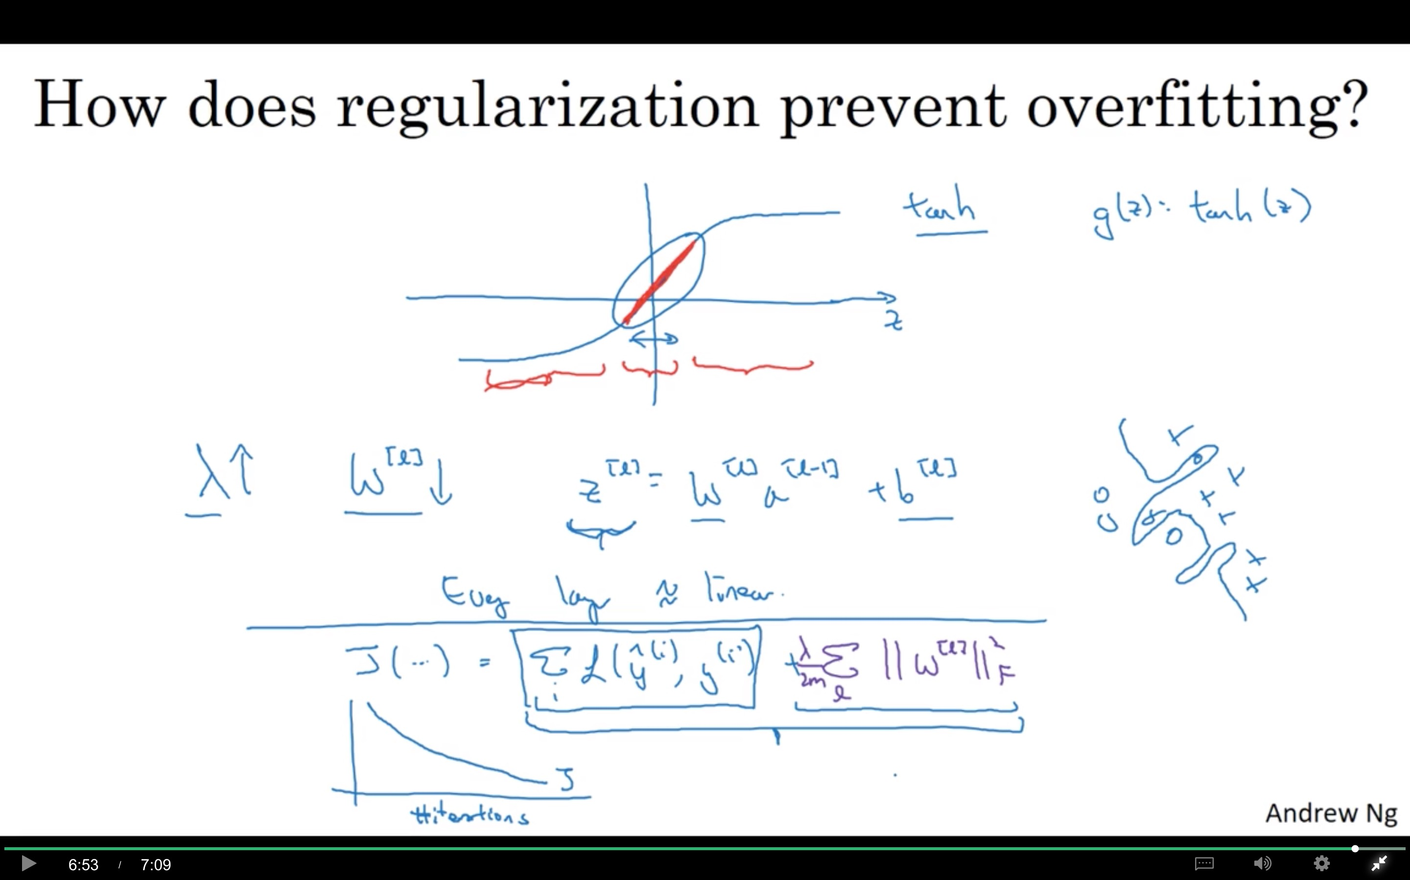

Slide 7
Regularizing your neural network
Dropout
regularization
deeplearning.ai

Slide 8
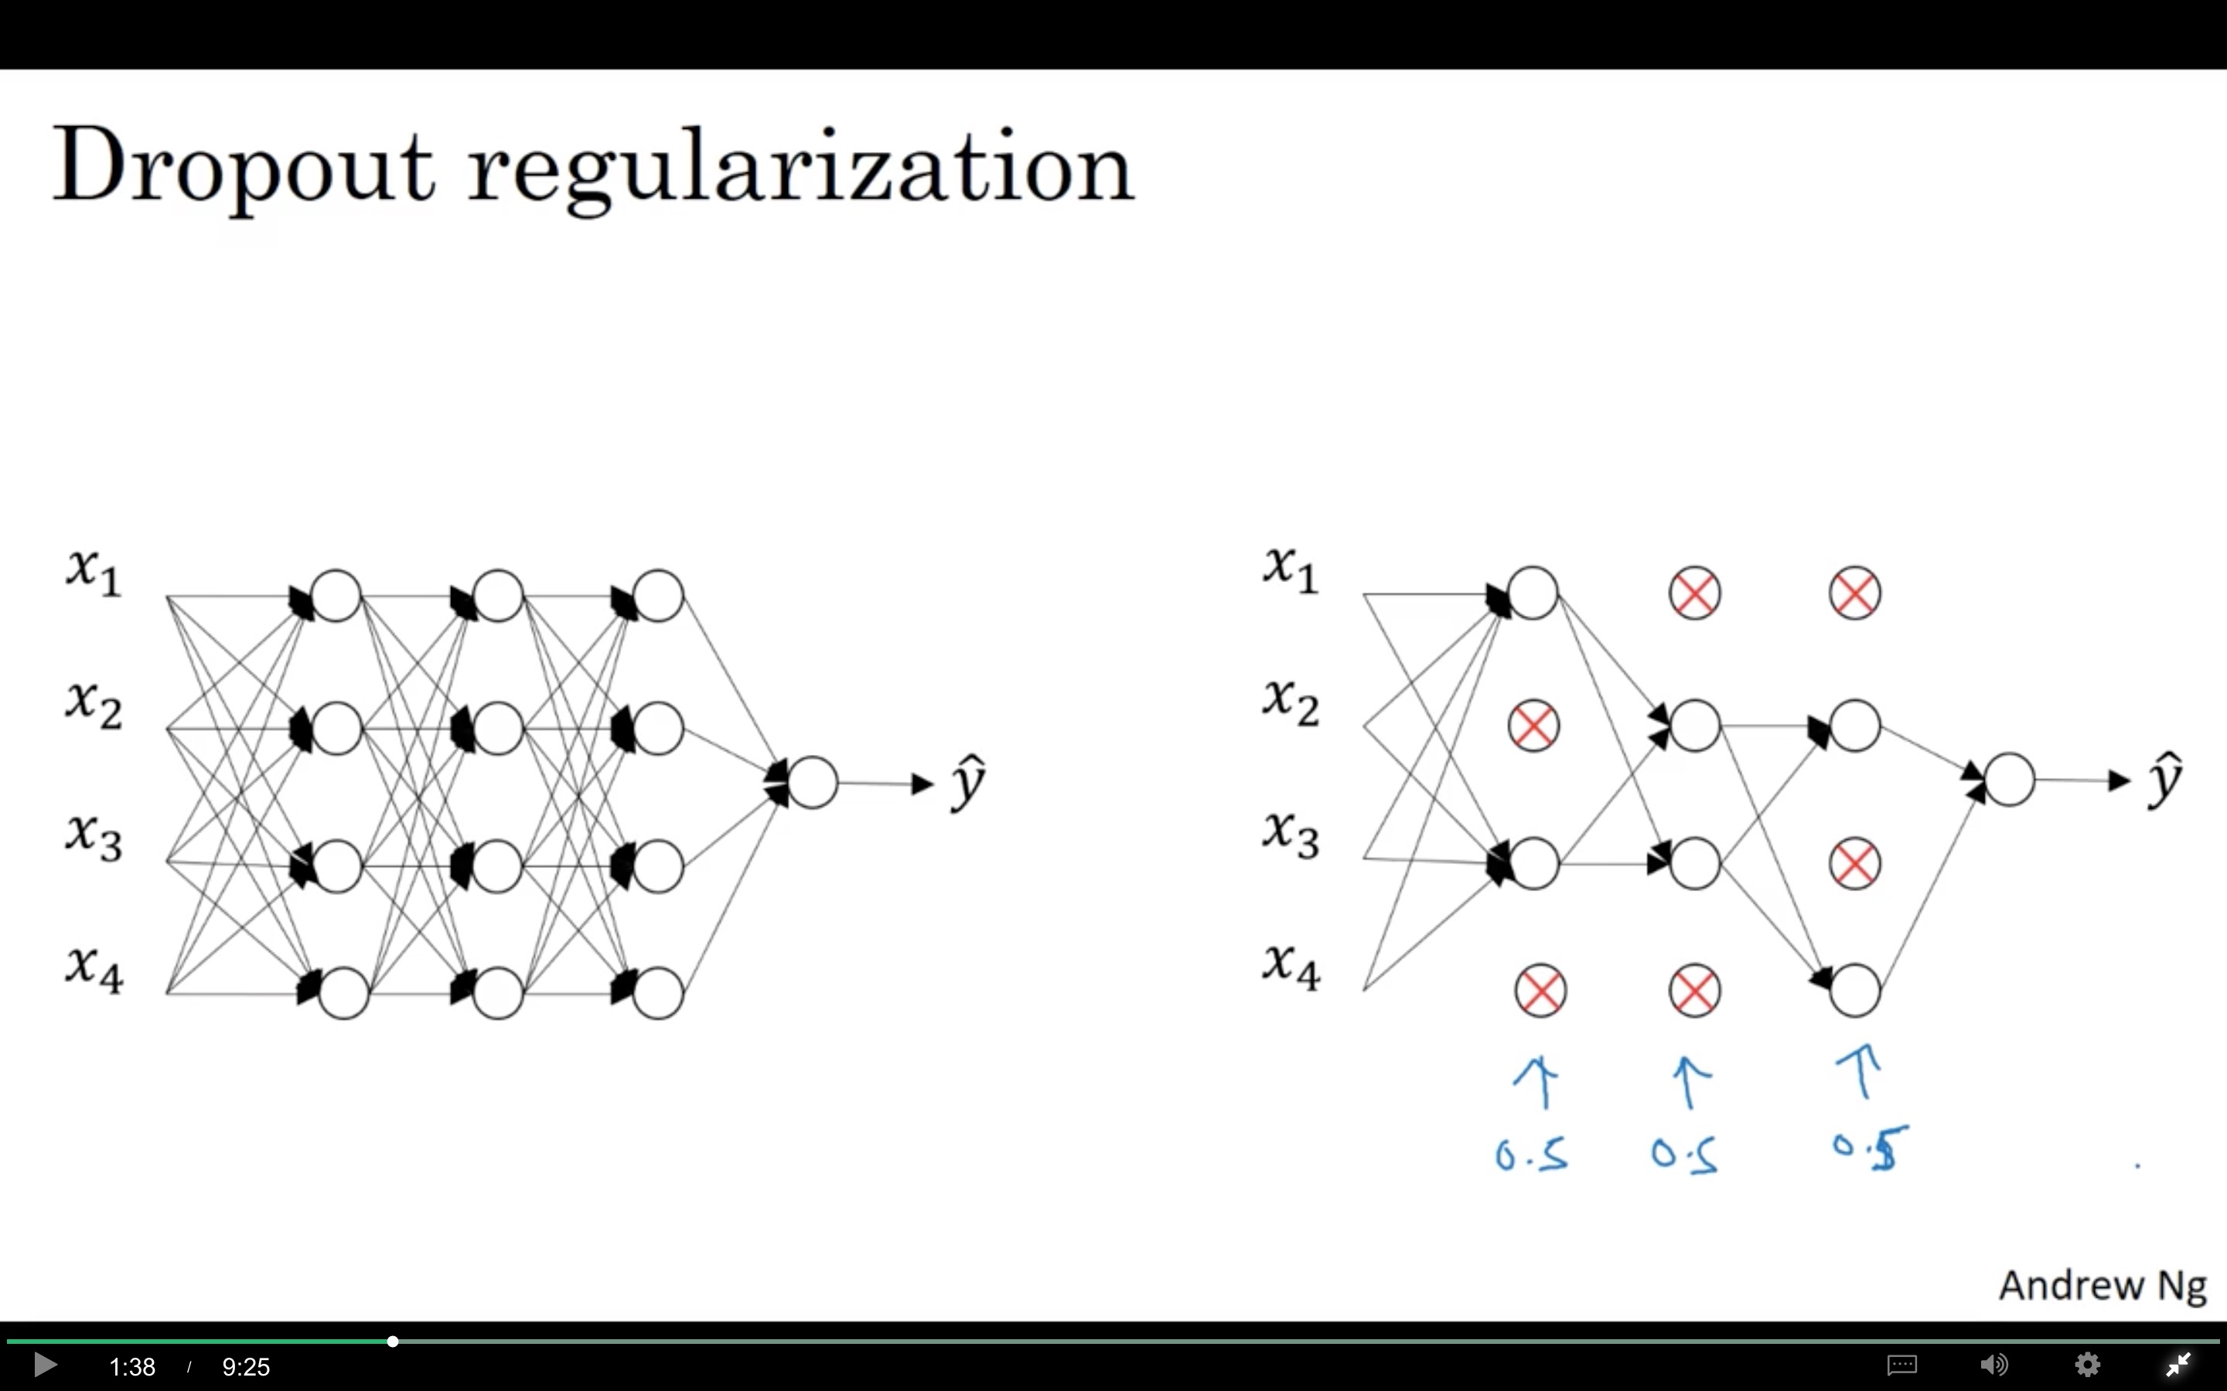

Slide 9
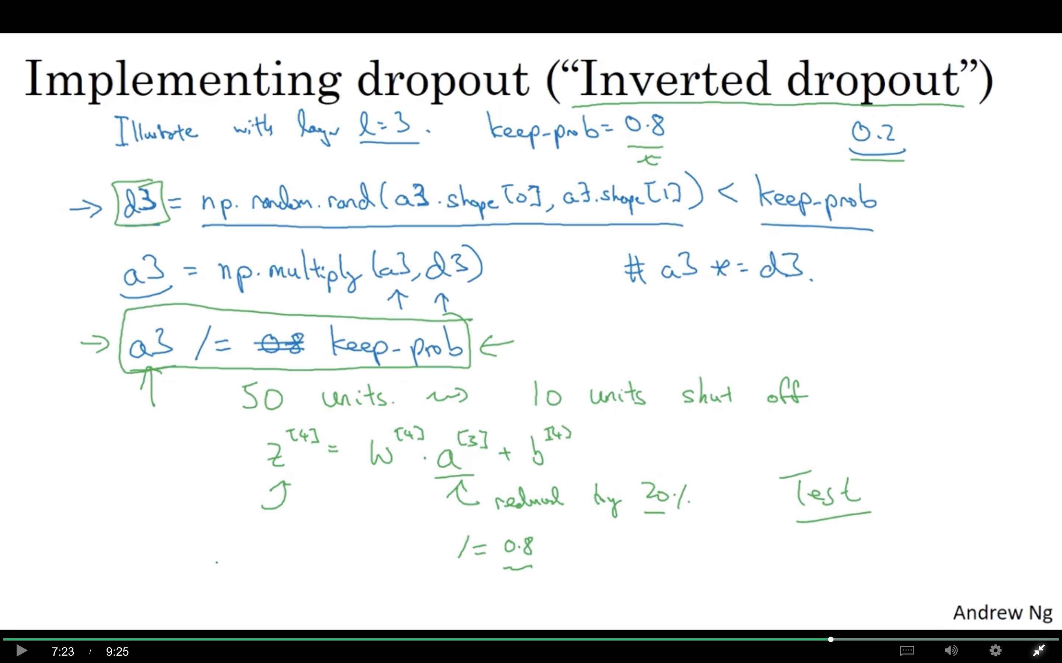

Slide 10
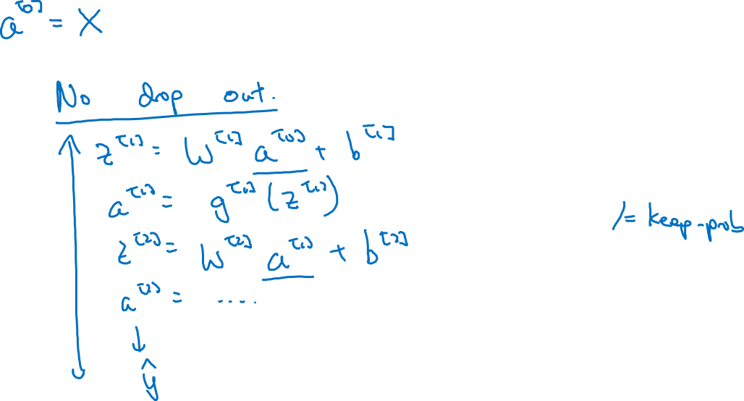
Making predictions at test time

Slide 11
Regularizing your neural network
Understanding
dropout
deeplearning.ai

Slide 12
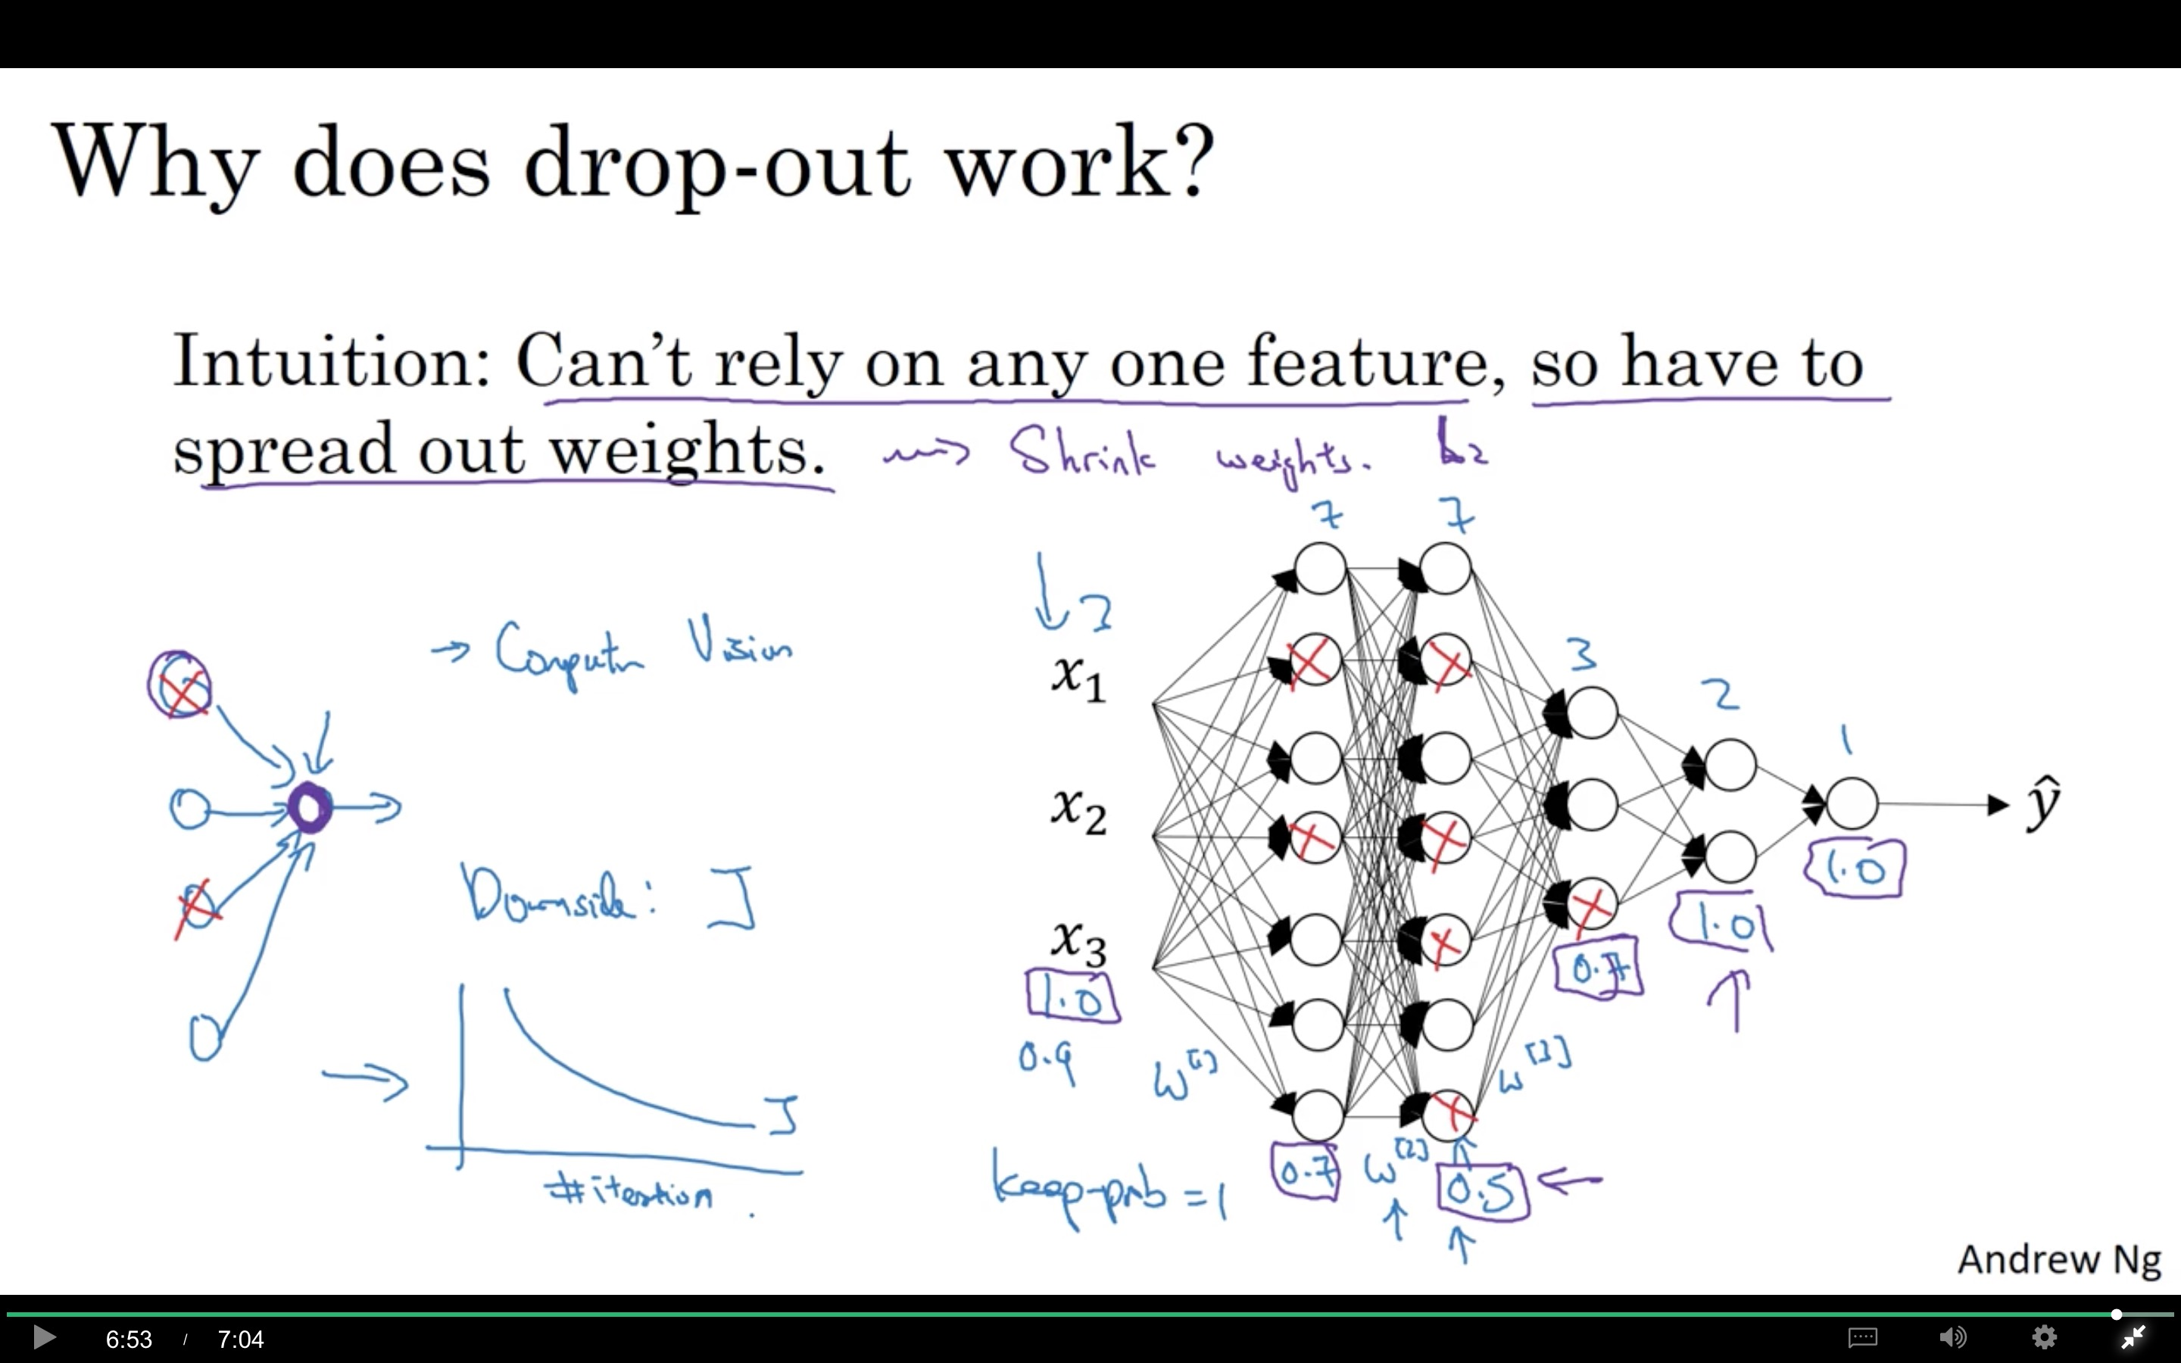

Slide 13
Regularizing your neural network
Other regularization
methods
deeplearning.ai

Slide 14



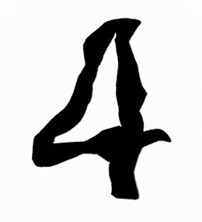
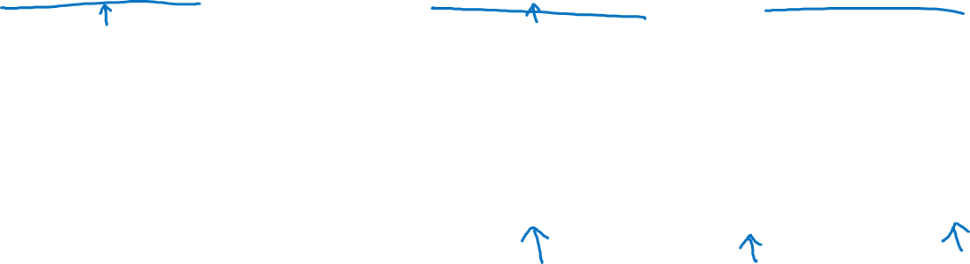
Data augmentation
4

Slide 15
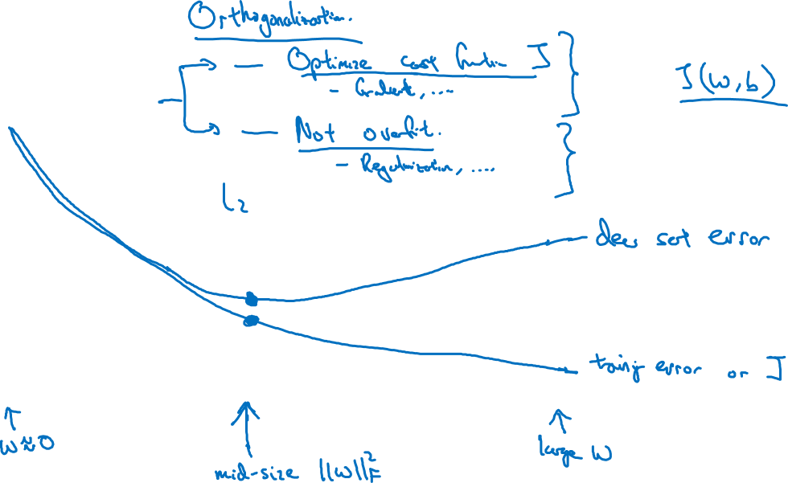
Early stopping
?
# iterations

